Slide 1
Introduction to Python
Day 1- Fundamentals of Python

Slide 2
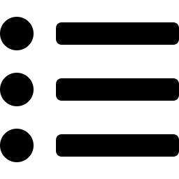
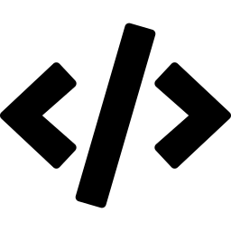








What We'll Cover
1. Introduction & Features
6. Translators
2. History of Python
7. Comments & Conditionals
3. Variables & Identifiers
8. Control Statements & Loops
4. Operators
9. Lists, Strings & Tuples
5. Memory & Garbage Collection
10. Recap
02

Slide 3
What is Python?
Python is a high-level, interpreted, and easy-to-learn programming language created by Guido van Rossum in 1991.
Key Features
Easy to Learn — simple, readable syntax
It's used across:
Interpreted — runs line by line
Web Development
Free & Open Source
AI & Machine Learning
Portable — Windows, Linux, macOS
Data Science
Object-Oriented
Automation
Large Standard Library
03

Slide 4
History of Python
1989
1991
2000
2008
Today
Guido van Rossum begins developing Python at CWI, Netherlands.
Python 0.9.0 released — classes, functions, exceptions.
Python 2.0 released — garbage collection, Unicode.
Python 3.0 introduced — improved efficiency.
One of the most popular languages worldwide.
04

Slide 5
Variables & Identifiers
A variable is a name used to store data. Its value can change during execution.
Identifiers
The name given to variables, functions, classes, modules, or objects.
name = "Rakshitha"
print(name) # Rakshitha
Variable
age = 20
Rules for Variables
Function
def add(): ...
Letters, numbers & underscores allowed
Cannot start with a number
Class
class Student: ...
Case-sensitive (Age ≠ age)
Module
import math
Object
s1 = Student()
05

Slide 6
CORE CONCEPTS
Operators in Python
An operator performs an operation on one or more values (operands). Python has 7 main types.
Arithmetic
Comparison
Assignment
Logical
+ - * / // % **
== != > < >= <=
= += -= *= /=
and or not
Bitwise
Membership
Identity
a is b
& | ^ ~ << >>
in , not in
is , is not
06

Slide 7
Memory & Garbage Collection
Memory Management
Object Lifecycle
Python automatically allocates memory when a variable is created, and frees it when no longer needed.
Program Starts
Create Objects
x = 10 # allocated
x = 20 # old value freed
Objects Used
Disadvantages: slightly slower than C/C++; uses extra memory for the manager.
Objects Become Unused
GC Removes Them
Garbage Collection
Automatically removes unused objects so memory can be reused.
Memory Becomes Free
07

Slide 8
EXECUTION
Translators & Their Types
A translator converts source code into machine code. There are three types:
Compiler
Interpreter ⭐
Assembler
Translates the entire program at once, before execution.
Translates & executes one line at a time.
Converts assembly language into machine code.
C, C++
Python uses this
MOV A,B → 101010100110
08

Slide 9
Comments & Conditional Statements
Comments
Types of Conditionals
Ignored by the interpreter — used to explain code.
if
Executes only when condition is True
# single-line comment
""" multi-line
comment """
if-else
One block if True, another if False
if-elif-else
Checks multiple conditions in order
Conditional Statements
Run different code blocks depending on True/False conditions.
Nested if
An if inside another if
if marks >= 35:
print("Pass")
else:
print("Fail")
Ternary
value_if_true if cond else value_if_false
09

Slide 10
Control Statements & Loops
Control Statements
Loops
break
Exit the loop immediately
for Loop
Iterates over a sequence (list, tuple, string, range).
continue
Skip to next iteration
for i in range(1, 6):
print(i)
pass
Do nothing (placeholder)
while Loop
for i in range(1, 11):
if i == 6:
break
print(i)
# Output: 1 2 3 4 5
Repeats while a condition stays True.
i = 1
while i <= 5:
print(i)
i += 1
10

Slide 11
Lists, Strings & Tuples
[ ]
List
" "
String
( )
Tuple
fruits = ["Apple", "Mango"]
name = "Python"
point = (10, 20)
Ordered & mutable
Ordered but immutable
Ordered & immutable
Allows duplicates
Supports slicing
Faster than lists
append(), sort(), pop()
upper(), split(), replace()
count(), index()
11

Slide 12
Thank You

